Slide 1

Module 5 Implementation Plan with Tiered Architecture
David Winter Software Development 1 CEN-3024C 2/08/2025

Slide 2
Zoomly Introduction and Recap
Scope
Requirements
A Vehicle Rental Management System
Allows users to reserve vehicles with specific date ranges for pickup and drop-offs
Allows users to manage their reservations and profiles
Allows administrators to access and manage all data information for reservations, users, and vehicles
User Features
Administration Features
Technical Considerations

Slide 3
User Features
Register for an account and manage profile details
View vehicles and filter by type and availability
Reserve vehicles by entering pick up and drop-off dates
Get notifications about overlapping reservations
View and manage their reservation history

Slide 4
Administrator Features
View and manage all vehicles, reservations, and user accounts
Change or cancel reservations when necessary
Resolve conflicts between overlapping reservations or user accounts

Slide 5
Technical Considerations
A backend to handle user logins, data storage, and business logic
A user friendly frontend that works well on a desktop environment with the capability of later being redesigned to work on other platform resolutions
A database to keep track of users, vehicles, and reservations
Error handling and notifications

Slide 6

UML Class Diagrams

Slide 7
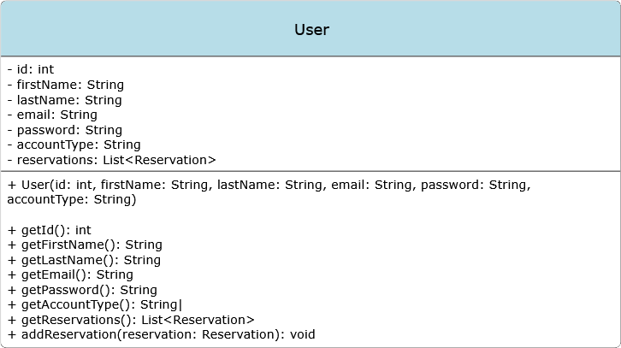
User Diagram

Slide 8
Attributes
id: Unique identifier for the user.
firstName: User's first name.
lastName: User's last name.
email: User's email address.
password: User's password for authentication.
accountType: Indicates if the user is a "user" or "admin".
reservations: A list of Reservation objects associated with the user.

Slide 9
Methods
Constructor: Initializes a new User object.
getId(): Returns the user's ID.
getFirstName(): Returns the user's first name.
getLastName(): Returns the user's last name.
getEmail(): Returns the user's email.
getPassword(): Returns the user's password (consider security implications).
getAccountType(): Returns the account type.
getReservations(): Returns the list of reservations made by the user.
addReservation(reservation: Reservation): Adds a reservation to the user's list.
Return Type: void because it modifies the state of the object without needing to return a value.

Slide 10
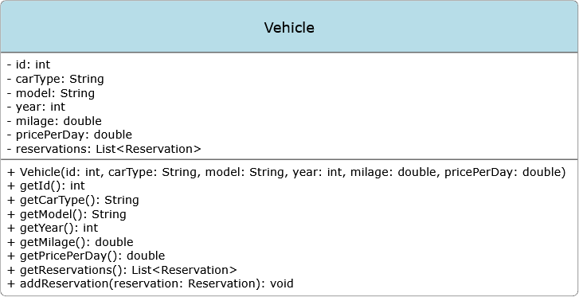
Vehicle Diagram

Slide 11
Attributes
id: Unique identifier for the vehicle.
carType: Type of vehicle (e.g., "car", "SUV", "pickup truck").
model: Vehicle model.
year: Year of manufacture.
milage: Total mileage of the vehicle.
pricePerDay: Rental price per day.
reservations: A list of Reservation objects associated with the vehicle.

Slide 12
Methods
Constructor: Initializes a new Vehicle object.
getId(): Returns the vehicle's ID.
getCarType(): Returns the type of the vehicle.
getModel(): Returns the vehicle model.
getYear(): Returns the year of manufacture.
getMilage(): Returns the total mileage.
getPricePerDay(): Returns the rental price per day.
getReservations(): Returns the list of reservations for the vehicle.
addReservation(reservation: Reservation): Adds a reservation to the vehicle's list.
Return Type: void for the same reason as in the User class.

Slide 13
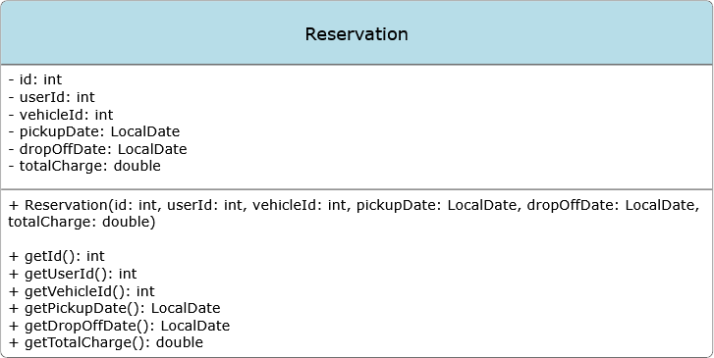
Vehicle Diagram

Slide 14
Attributes
id: Unique identifier for the reservation.
userId: ID of the user making the reservation.
vehicleId: ID of the reserved vehicle.
pickupDate: Date when the vehicle is picked up.
dropOffDate: Date when the vehicle is returned.
totalCharge: Total cost of the reservation.

Slide 15
Methods
Constructor: Initializes a new Reservation object.
getId(): Returns the reservation ID.
getUserId(): Returns the ID of the user who made the reservation.
getVehicleId(): Returns the ID of the reserved vehicle.
getPickupDate(): Returns the pickup date.
getDropOffDate(): Returns the drop-off date.
getTotalCharge(): Returns the total charge for the reservation.

Slide 16

Architecture

Slide 17
Client Server
Allows for real-time vehicle reservations and account management
Easy to scale and increase resources with increase user requests
All data transactions occur on the server ensure for up-to-date information

Slide 18
Other Considerations
Architecture | Use Case | Limitations
Stream-Based | Continuous data processing | Not suitable for multiuser access
Repository | Data storage and retrieval | Lacks multiuser and load management
Layered | Modular design | Doesn’t address multiuser interactions
MVC | GUI code organization | Focuses on structure, not architecture

Slide 19

Coding Strategy

Slide 20
User Interface Layer
Framework: JavaFX for GUI
MVC Architecture:
Represent data for business logic
Display data and handle user interaction
Manage the flow of data between the model and view
Event Handling: Use Event listeners for user interactions i.e. button clicks
Form Validation: Implement input validation before sending to business logic layer

Slide 21
Business Logic Layer
Service Classes: Create service classes such as UserService, VehicleService, and ReservationService to encapsulate the business logic
Error Handling: Implement custom exceptions to handle business logic errors
Collections and Generics: Use collections (e.g., ArrayList, HashMap) to manage lists of vehicles, users, and reservations.
Interfaces: Define interfaces for services (e.g., IVehicleService, IUserService) to allow for testing and implementation of different service strategies

Slide 22
Database Layer
Database Management: Use JDBC (Java Database Connectivity) to connect to the database
SQL Queries: Write SQL queries for CRUD (Create, Read, Update, Delete) operations. Use prepared statements to prevent SQL injection attacks

Slide 23

GUI Mockup

Slide 24
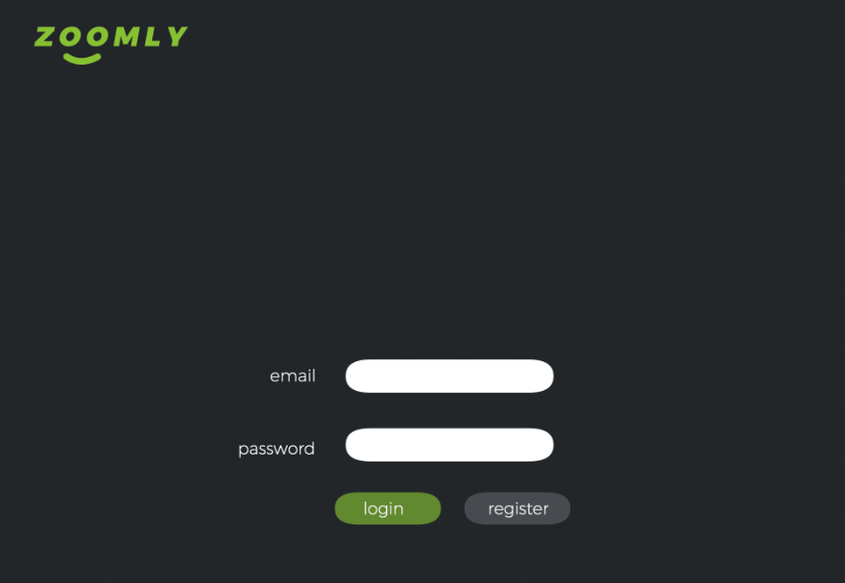

Slide 25
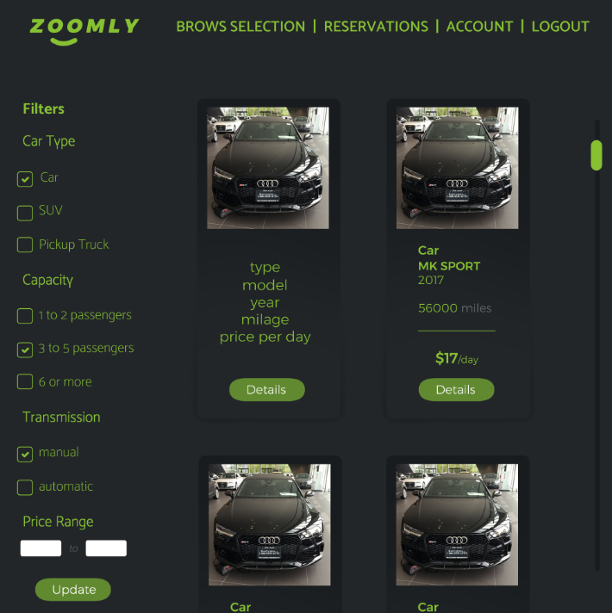

Slide 26
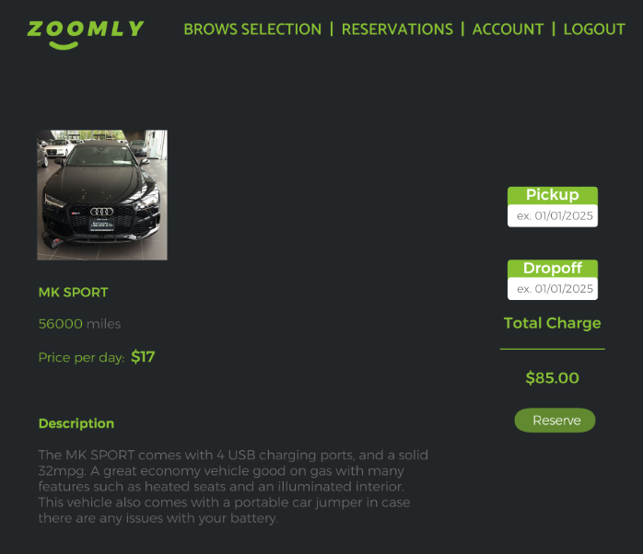

Slide 27
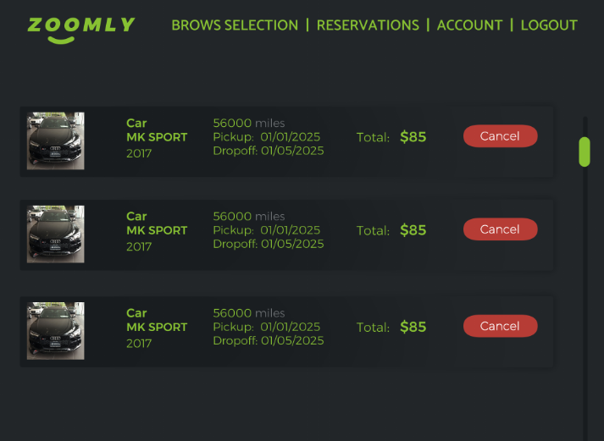

Slide 28
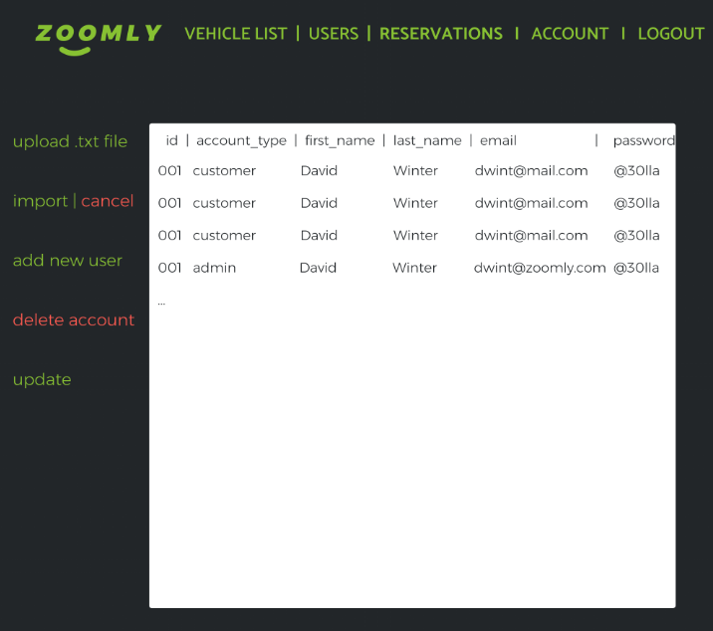

Slide 29
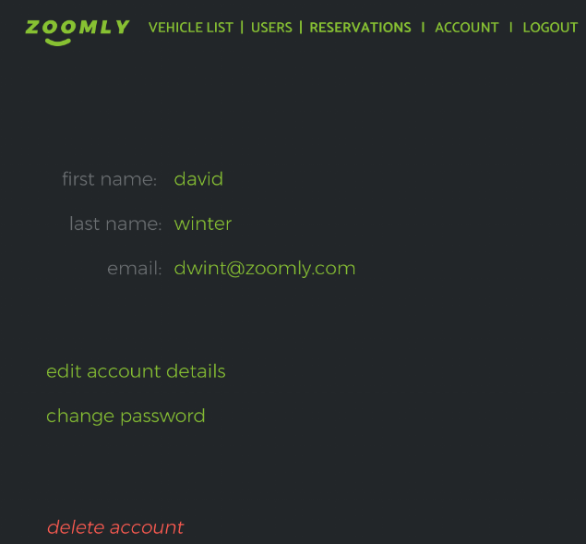

Slide 30

Phase 1 Logic and Data Validation

Slide 31
Objectives
Implement CRUD operations and custom actions using Java objects.
Validate user input to prevent invalid data entry and ensure program stability.
*No GUI needed in this phase
*No database needed in this phase

Slide 32
Project Structure
Use IntelliJ IDEA as the main IDE for development.
Organize the project into packages:
com.example.project (root package)
com.example.project.models
(for User, Vehicle, Reservation)
com.example.project.services
(for business logic and CRUD operations)
com.example.project.utils
(for utility classes, e.g., input validation)
com.example.project.cli
(for command-line interface handling)

Slide 33
Version Control
GitHub
Main
Branch Naming
Phase-1
Phase-2
Phase-3
Phase-4

Slide 34
Potential Classes and Methods
User Class
Attributes: id, firstName, lastName, email, password, accountType, reservations
Methods:
Constructor
Getters and Setters
addReservation(Reservation reservation): void

Slide 35
Potential Classes and Methods
Vehicle Class
Attributes: id, carType, model, year, milage, pricePerDay, reservations
Methods:
Constructor
Getters and Setters
addReservation(Reservation reservation): void

Slide 36
Potential Classes and Methods
Reservation Class
Attributes: id, userId, vehicleId, pickupDate, dropOffDate, totalCharge
Methods:
Constructor
Getters and Setters

Slide 37
CRUD Service Classes
Reservation Class
(UserService, VehicleService, ReservationService..)
Methods for managing CRUD operations:
createUser(User user): void
readUser(int userId): User
updateUser(User user): void
deleteUser(int userId): void
Similar methods for Vehicle and Reservation.

Slide 38
Input Validation Utility
Methods for validating user input:
validateEmail(String email): boolean
validateDate(LocalDate date): boolean
validateUserData(User user): Boolean
Similar methods for validation

Slide 39
CLI Handler
Methods for handling user interactions via the CLI:
showMenu(): void
loadDataFromFile(String filePath): void
addNewUser(): void
addNewVehicle(): void
addNewReservation(): void
Similar methods for CLI handler

Slide 40

Phase 2 Testing

Slide 41
Objectives
Test the logic implemented in Phase 1 using unit tests.
Fix any bugs and enhance functionality.
*No GUI needed in this phase
*No database needed in this phase

Slide 42
Potential Classes and Methods
Test Classes (using JUnit)
UserServiceTest
VehicleServiceTest
ReservationServiceTest
Each class should contain test methods for each CRUD operation:
testCreateUser(): void
testReadUser(): void
testUpdateUser(): void
testDeleteUser(): void

Slide 43
Execution
Manually create test data within the test classes to validate functionality
Write tests to verify exceptions during file handling
Run tests and review results in the CLI.
Fix identified bugs and re-test to ensure stability.

Slide 44

Phase 3 GUI

Slide 45
Objectives
Introduce a graphical user interface to the project.
Implement all CRUD operations and custom actions through the GUI.
*No database needed in this phase

Slide 46
Potential Classes and Methods
Main GUI Class (MainFrame):
Methods for initializing the GUI components:
initializeUI(): void
createMenuBar(): void
createUserForm(): void
createVehicleForm(): void
createReservationForm(): void

Slide 47
Potential Classes and Methods
Event Handlers
Implement action listeners for buttons:
onAddUserButtonClicked(): void
onAddVehicleButtonClicked(): void
onLoadDataButtonClicked(): void
Input Validation:
Use the validation utility from Phase 1 to validate inputs in the GUI.
Output Handling:
Display all outputs in GUI components (e.g., text areas, labels).

Slide 48

Phase 4 Database Integration

Slide 49
Objectives
Integrate a database into the project to manage data persistence.
Implement CRUD operations and custom actions using the database.

Slide 50
Potential Classes and Methods
Database Connection Class (DatabaseConnection):
Methods for establishing and managing database connections:
Create a DatabaseConnection class to manage connections.
Implement connect() and disconnect() methods to handle opening and closing database connections efficiently.

Slide 51
Potential Classes and Methods
Database Service Classes
(UserDatabaseService, VehicleDatabaseService, ReservationDatabaseService)
Implement methods to interact with the database:
createUser(User user): void
readUser(int userId): User
updateUser(User user): void
deleteUser(int userId): void
Similar methods for Vehicle and Reservation

Slide 52
SQL Parameters
Use Prepared Statements to prevent SQL injection attacks.
Ensure all SQL commands parameterize inputs to enhance security.
Example:
String sql = "INSERT INTO users (firstName, lastName, email) VALUES (?, ?, ?)";
PreparedStatement preparedStatement = connection.prepareStatement(sql);
preparedStatement.setString(1, user.getFirstName());
preparedStatement.setString(2, user.getLastName());
preparedStatement.setString(3, user.getEmail());

Slide 53
Error Handling and Transactions
Error Handling:
Implement error handling for SQL operations, catching exceptions and providing meaningful feedback to users.
If possible, log errors for debugging purposes.
Transactions:
Use transactions for operations involving multiple steps to maintain data integrity.
Example of transaction management:

Slide 54

THANK YOU
For your attention!

